Slide 1
Business Applications
Dynamics 365 and Power Platform: Extending the Power Platform

Slide 2

Agenda
Dynamics 365 and Power Platform: Extending the Power Platform
Whiteboard Design Session: Designing a collaborative Microsoft 365 environment that includes power platform and D365 integrations. We will be collaborating with the Modern Workplace group for this one!
Team Challenge: Delivering a collaborative Microsoft 365 environment that includes power platform and D365 integrations.

Slide 3
Daily Rundown
Timeframe | Activity | Engagement
8:00 – 9:00 | Extending the Power Platform | Interactive Discussion
9:00 – 11:00 | Whiteboard Design Session
11:00 – 12:00 | Long Break
12:00 – 2:00 | Team Challenge | Hands On: Group Work
2:00 – 2:15 | Wrap Up (Office Hours)

Slide 4
Extended Platform
Notes:
The power platform is much like the universe: it is forever expanding. Just when you think you’ve found the limit, it will grow.
One of the greatest strengths of the Power Platform (and by now you’re used to me saying this phrase… there are a lot of great strengths), is that it’s able to continue growing – and as Microsoft continues to invest in it things will only get better!
Today we’re going to touch on some of the “Additional” features of the Power Platform. Some, like Power Automate, are officially part of the Power Platform. Others, like Power Virtual Agents and Teams, provide users with additional tools and features to support their business processes.

Slide 5
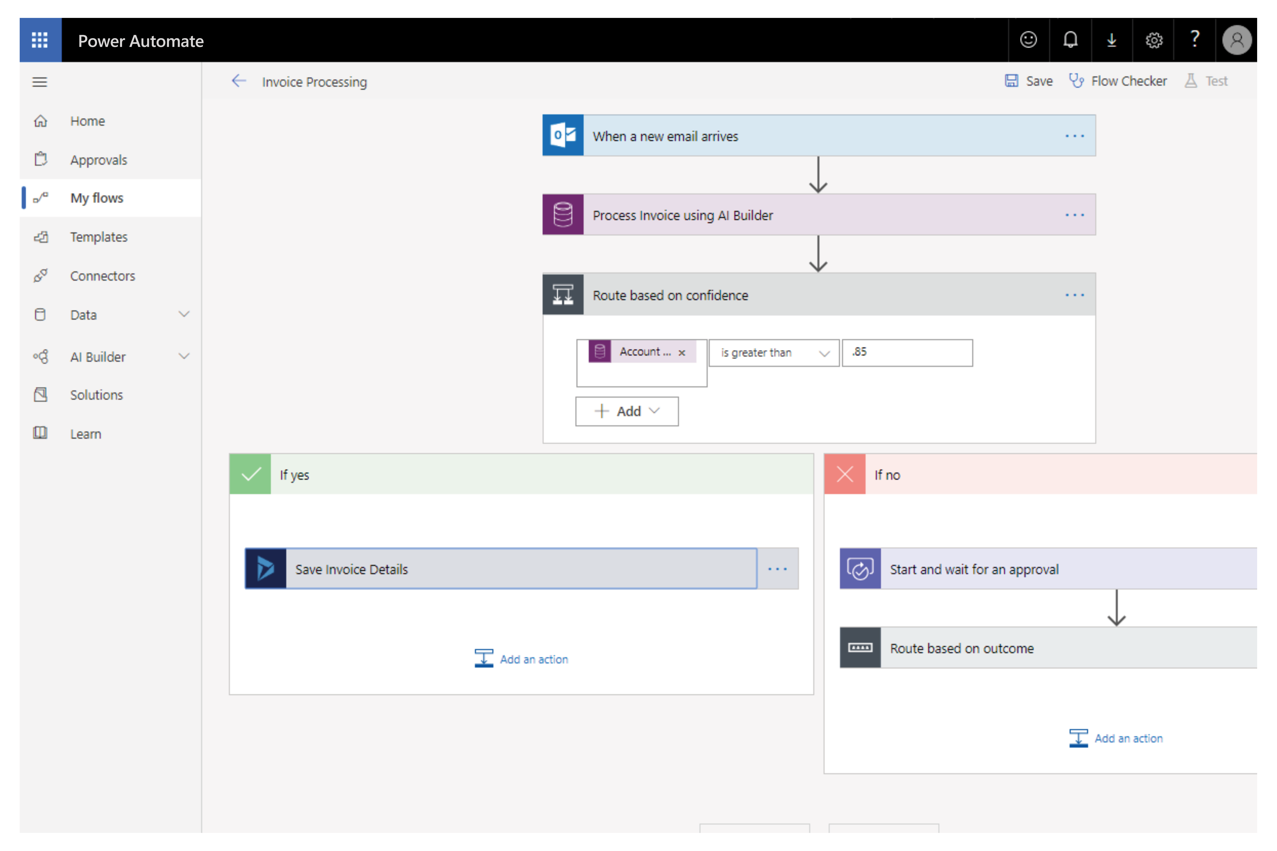
Automate and integrate business processes with Power Automate
Automate and model business processes across your apps and services
From simple automations to advanced scenarios with branches, loops, and more
Trigger actions, grant approvals, and get notifications right where you work
Automate legacy, on-prem and cloud-based applications and services
Notes:
Who remembers what Power Automate was called just a year ago? Flow.
Now we create a Flow inside of Power Automate.
Flow is built on the idea of triggers and actions, with hundreds of connectors (Including the CDS, Sharepoint, and even non-Microsoft products).
Have a customer inquiry posted to a Teams channel
Create an approval process
Use a flow button to turn on your home sprinkler system!
If you’re curious to learn more, check out the blog links for Ed Gonzales or David Yack. Both MVP’s with infectious loves of Power Automate.

Slide 6
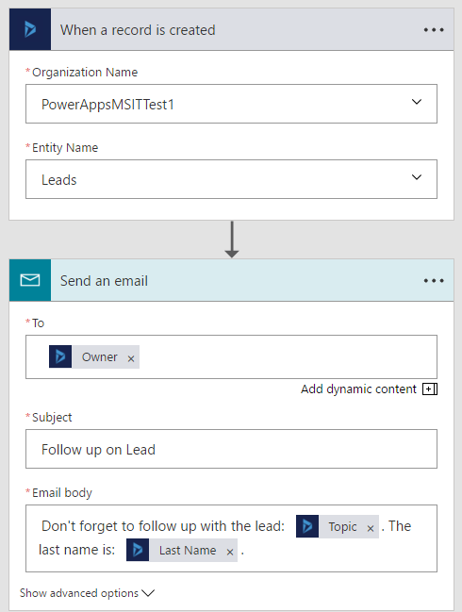
What makes up a Flow?
Example: Notification Flow
Trigger – the event that kicks off the flow:
manually
on a schedule
on an event in the cloud
Actions – what the flow does
Can use data from the trigger
Notes:
In addition to utilizing Templates, end-users can easily build their own Flows or customize any of the available templates through an easy to use visual designer.
In this example I want to receive and email in my Exchange email box every time a new file gets added to my Dropbox account.
Simply select the “Dropbox - When a file is created” trigger and provide my account details to authenticate. Once authenticated and can simplify select the folder I want to monitor on my account.
As a next step, I select the Office 365 Outlook – Send email function. This will prompt me to logon to my O365 email account. I have different properties available which I use directly in the subject, body an ‘To’ address of the message that will be send based on the Drop box trigger.
I simply save the Flow I just created, and it is now ready for execution.

Slide 7
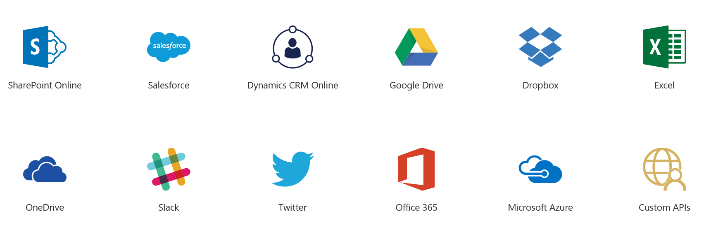

Connect to cloud and on premises data
Over 170 out of the box connectors with new connectors every week
Use Custom Connectors to connect to any custom REST endpoint
Connect to on-premises data using gateways
Notes:
These connectors are common across Flow and PowerApps.
Connectors include Microsoft services (O365 and D365) and external services too – MailChimp, Salesforce, Slack etc.

Slide 8
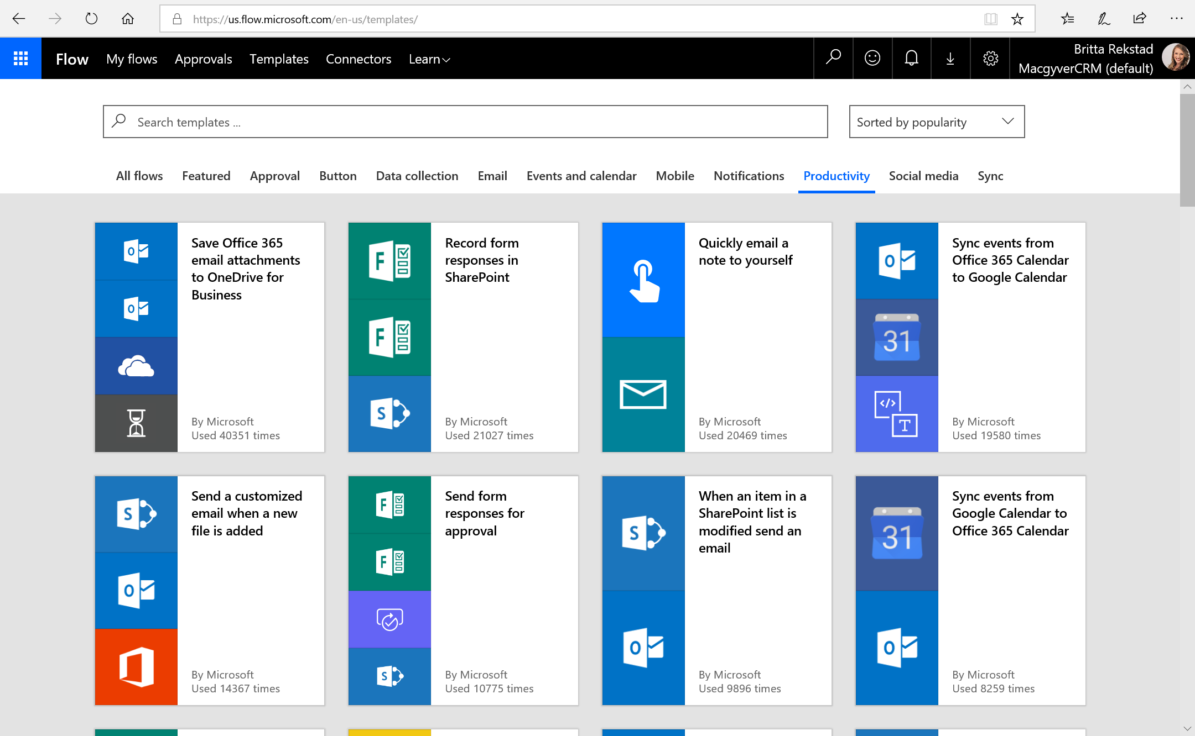
Notes:
Templates are pre-built flows for popular and common scenarios. Using a template only requires you to have access to the services in the template and to fill out any required settings.

Slide 9
Demo – Power Automate
Notes:
Template and/or Custom flow

Slide 10
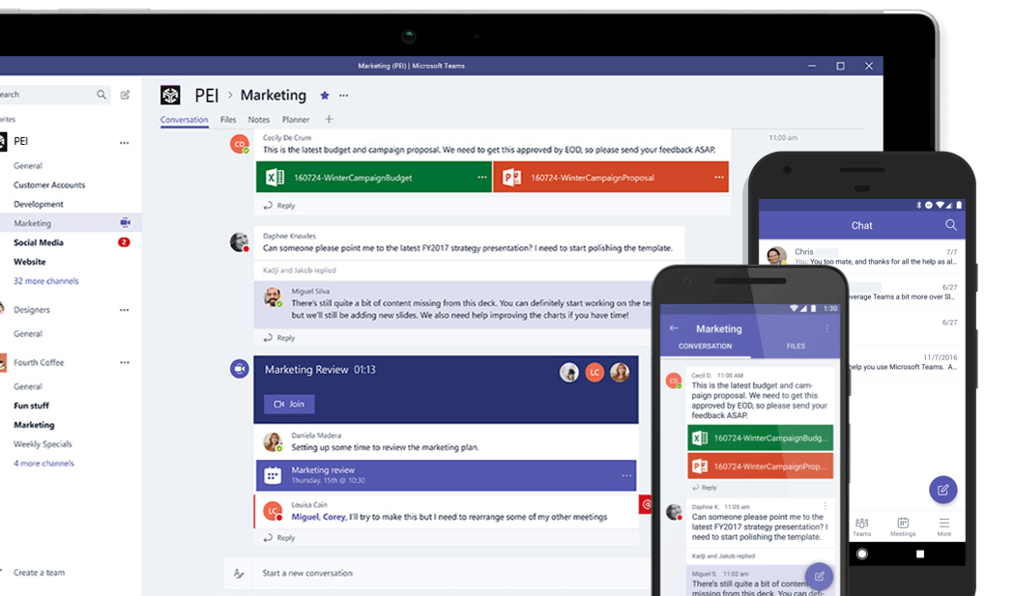
Teams
Display Powerapps (including Dynamics apps) and interact with data within Teams
Use Bots to communicate
With project oakdale, create powerapps and bots from within Teams
Notes:
There are many ways to expand the Power Platform using teams.
You can display a canvas app in teams, for users to interact with.
Add a Dynamics tab to display a window into a dynamics app right inside a teams channel (where users can use the Dyamics app as if they were in a separate browser!)
Use the Dynamics Bot to search for “Open Leads” for contacts and link them to their open leads in Dynamics.
With the addition of Project Oakdale (which is sometimes unofficially referred to as “CDS Lite”), you can create Apps right from within Teams. Project Oakdale delivers a built-in, low-code data platform for Teams and enables everyone to easily build and deploy apps and intelligent chatbots in Teams with Microsoft Power Apps and Microsoft Power Virtual Agents. This fully integrated Power App authoring experience optimized for Microsoft Teams allows creators to build, deploy, share, use and administer Power Apps solutions from within Teams.
A few things to consider– Project Oakdale will create a new environment. So when you create an app, you are not connecting to your current CDS database. And connecting that data is not simple or easy (or seamless). However, keep in mind that Project Oakdale is very new and will likely include changes and updates in the coming years – so keep an eye out for these!
If you need to connect with CDS, there are many ways to connect your CDS database, and even Canvas Apps, to your teams environment.

Slide 11
Demo – Teams (Project Oakdale)
Notes:
Build a powerapp inside of Teams

Slide 12
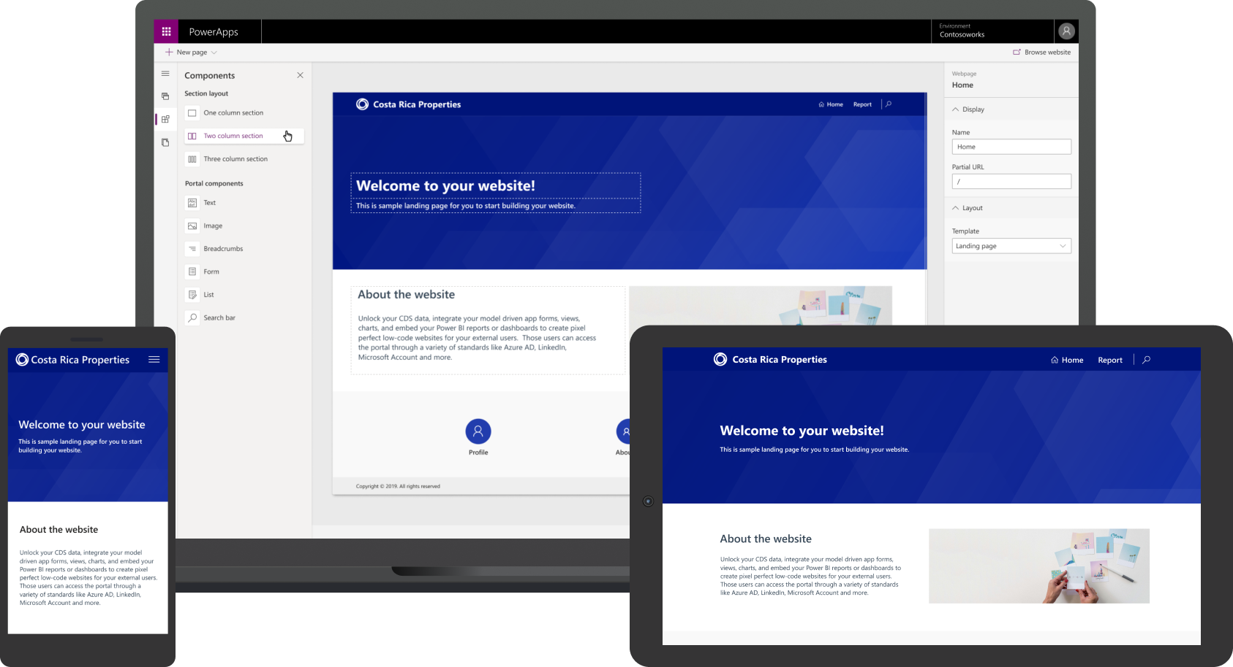
Allow clients to interact with CDS data securely with Power Apps Portals
Engage with external customers and partners
Enable anyone to build responsive websites
Integrate all of your data
Notes:
Give internal and external users secure access to your data either anonymously or through commercial authentication providers like LinkedIn, Microsoft, Facebook, and Google, or enterprise providers such as Azure AD B2C and Okta. Set authentication requirements, customize data for each user, and allow users to submit their information privately with straightforward admin controls.
Easily match websites to the look and feel of your branding with customizable portal templates and responsive themes. Create and manage the content external users and partners can access using an intuitive interface and step-by-step guidance—no code required.

Slide 13
Demo – Portals
Notes:
We’ve already worked with portals a lot this week, so I’ll be skipping this demo to save time.

Slide 14

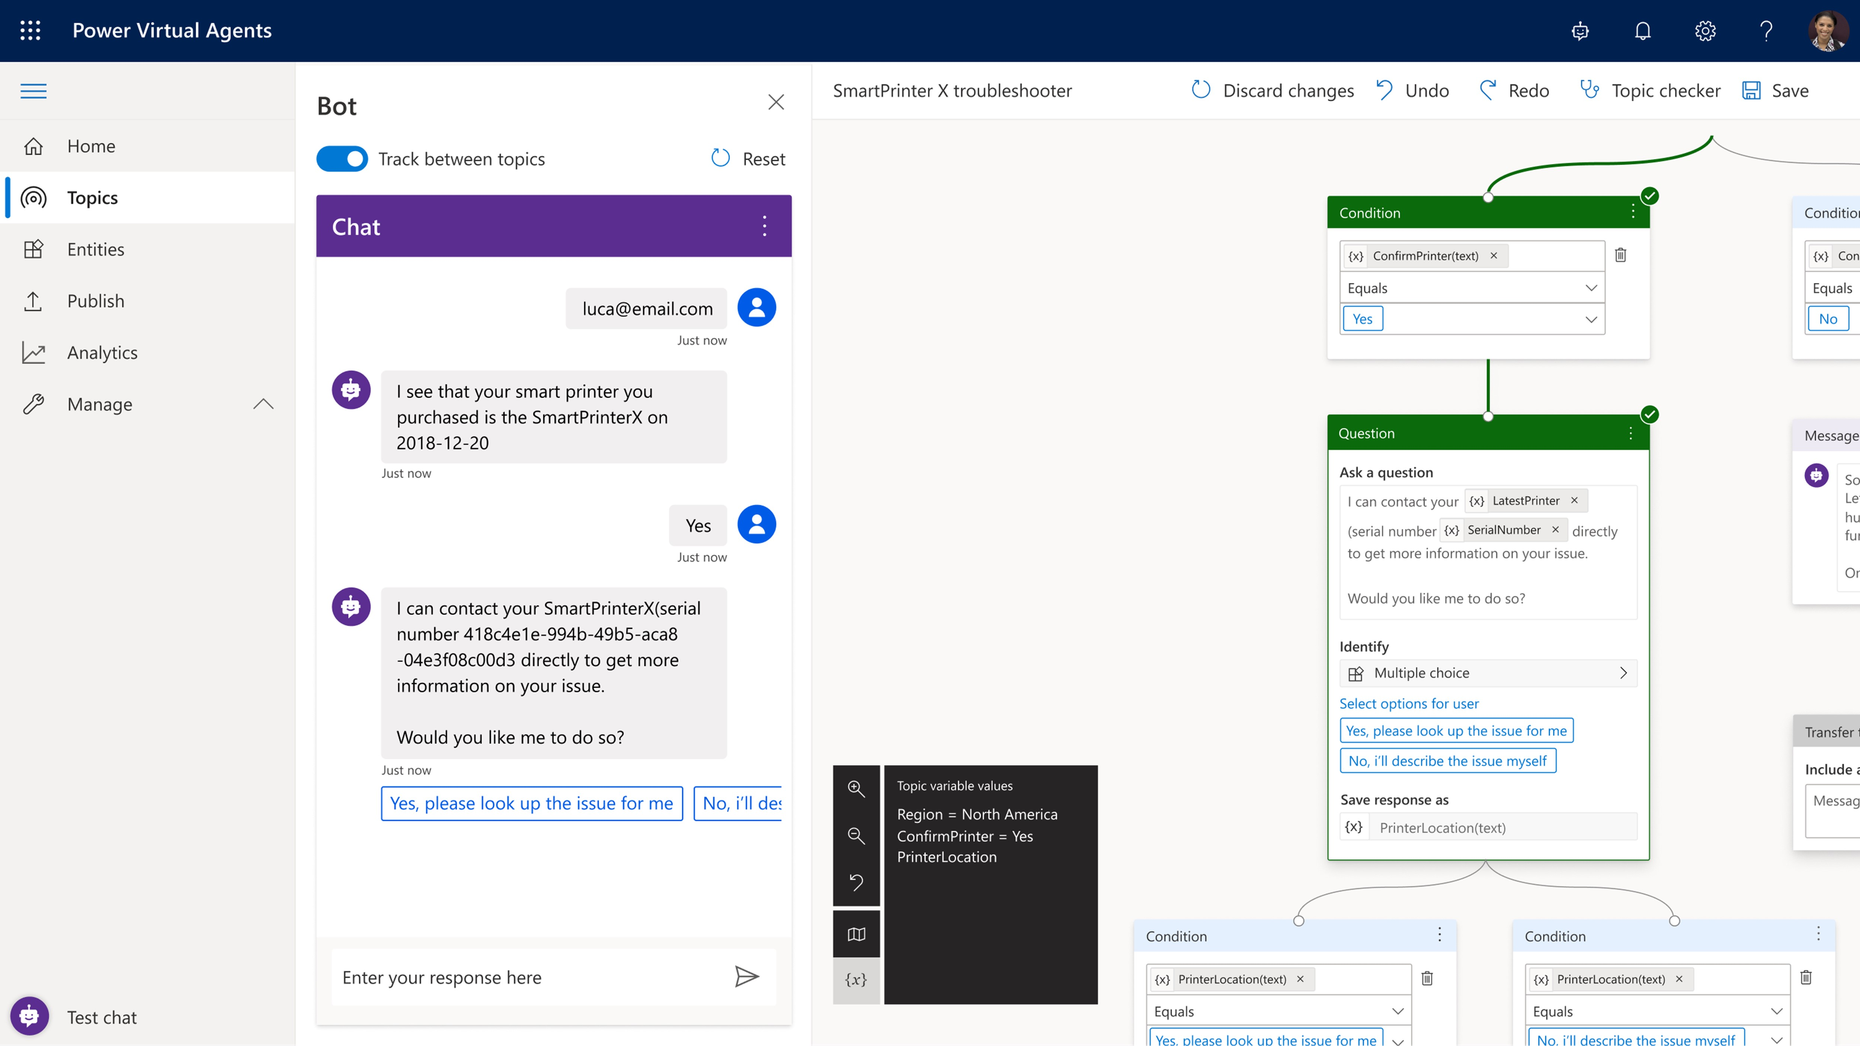
Build powerful virtual agents with Power Virtual Agents
Enable subject matter experts to easily create powerful virtual agents using a guided, no-code graphical interface—all without the need for data scientists or developers
Enable the virtual agent to take action on the customer’s behalf; Easily integrate your virtual agent with hundreds of services and systems out of the box or create custom workflows
Keep an eye on how your virtual agent is performing by using conversational metrics and dashboards; Get in-depth AI-driven insights to improve bot performance

Slide 15
Demo – Power Virtual Agent
Notes:
Create Bot and integrate with Teams

Slide 16
Gain insights from your data regardless of where it lives with Power BI
Connect to all your data and get a consolidated view across your business through a single pane of glass
Create ad-hoc analysis, live dashboards and interactive reports that are easy to consume on the web and across mobile devices
Build smart apps by infusing insights from your data and drive action with the power of the Power Platform
Notes:
Power BI is for organizations that want to create a data-driven culture. All of an organization’s data, across the business and from multiple locations/databases can be transformed and used to build analysis, dashboards, and reports.
Power BI is for creating data experiences.

Slide 17
Demo – Power BI
Notes:
Show CC Demo Dashboard and integration with Teams

Slide 18

Whiteboard Design Session
Design a collaborative Microsoft 365 environment that includes Power Platform and Dynamics 365 integrations.

Slide 19
Long Break
Please return to the session by 12:00pm PT

Slide 20
Team Challenge
Delivering a collaborative Microsoft 365 environment that includes power platform and D365 integrations.

Slide 21
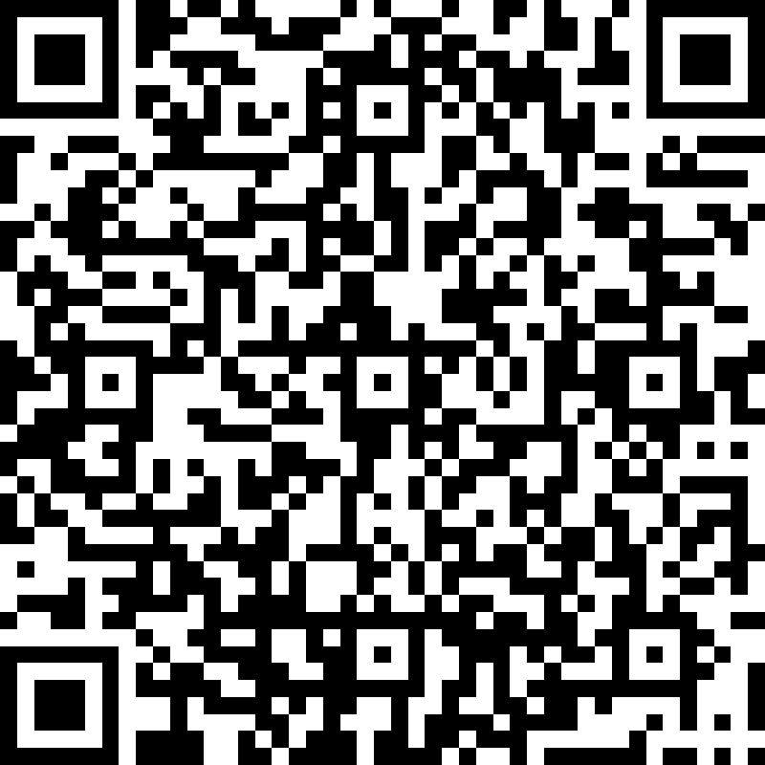
Survey
https://aka.ms/CloudCoresurvey

Slide 22
Office Hours

